Slide 1
Creating Page Layouts w/CSS
CS 130: Tools and Technologies of the World Wide Web
Spring, 2022

Slide 2
Outline
The Box Model
Semantic Tags (a reminder)
Media Queries
Intro to Flexbox

Slide 3
CSS & Layouts
Layouts are the hardest thing about CSS for many reasons:
The language has many, many different layout ‘paradigms’ for doing the same thing.
Specifying the rules for arranging boxes the right way is difficult
You have to design for several different browser configurations (what looks good on a desktop doesn’t necessarily look good on mobile).
Everything has to be flexible and resizable so that it scales gracefully.

Slide 4
Layout Tips
Learn Flexbox (Today) – it’s worth the investment!
Learn CSS Grid (Wednesday, Tutorial 4) – also worth the investment
Design your website so that it is responsive (looks good on a mobile, tablet, and desktop). Using Flexbox and CSS Grid will help you with mobile layouts.
Avoid older hacks (floats, putting everything inside a table, absolute positioning) – or else use as a last resort.
We’ll go through some examples today and on Wednesday.

Slide 5
Activity: Composing a Layout in CSS
Let’s deconstruct this template website:
How does this website instantiate the principles of:
Proximity (think whitespace)
Alignment (think grid)
Repetition
Contrast
Let’s draw some boxes...
Let’s think about how to create this layout. Some properties to highlight:
Responsiveness
relative units
Margin and padding!

Slide 6
Outline
The Box Model
Semantic Tags (a reminder)
Media Queries
Intro to Flexbox

Slide 7
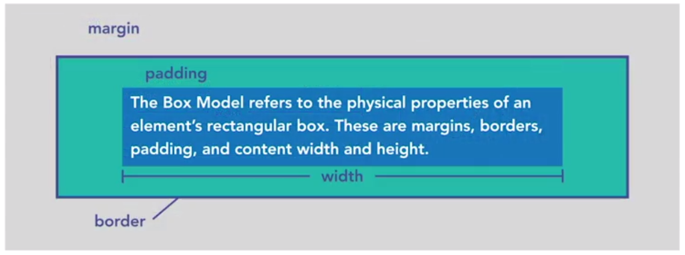
The Box Model
References:
W3 Schools
Lynda.com Video

Slide 8
The Box Model
margin
padding
border
width
box-sizing (border-box v. content box)
display (block, inline-block, inline, grid, none, etc.)

Slide 9
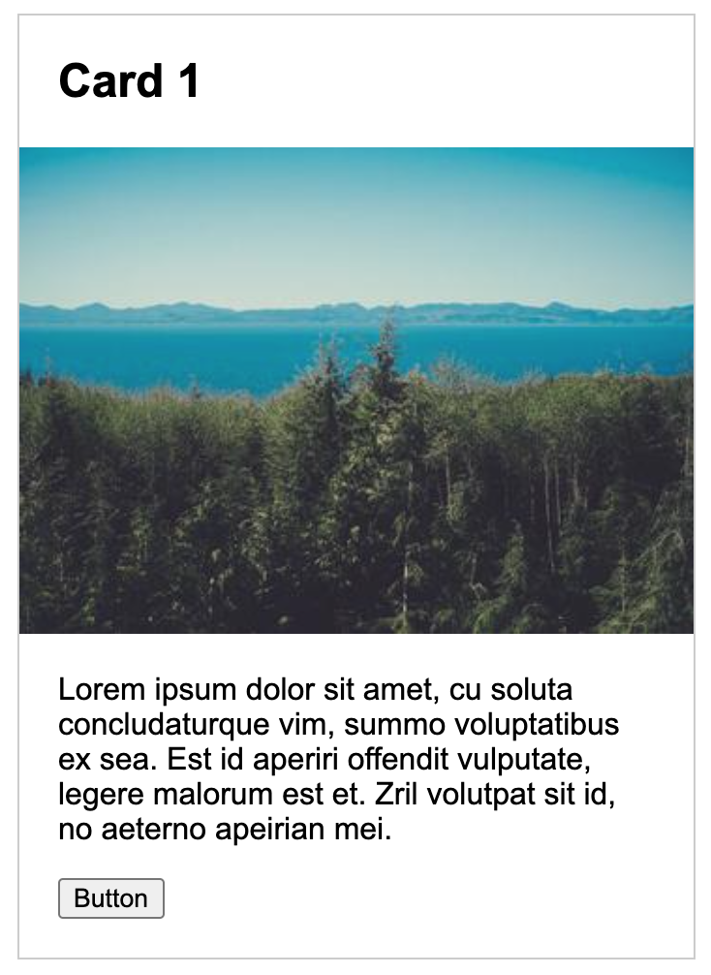
Exercise 1: Box Model
Open 01-box-model and create this card:

Slide 10
Outline
The Box Model
Semantic Tags (a reminder)
Media Queries
Intro to Flexbox

Slide 11
Semantic, Block-Level Elements
<address> <article> <aside> <blockquote> <canvas> <dd> <div> <dl> <dt> <fieldset> <figcaption> <figure> <footer> <form> <h1>-<h6> <header> <hr> <li> <main> <nav> <noscript> <ol> <p> <pre> <section> <table> <tfoot> <ul> <video>
https://codepen.io/vanwars/pen/WWRqRY?editors=0100

Slide 12
Semantic, Inline Elements
<a> <abbr> <acronym> <b> <bdo> <big> <br> <button> <cite> <code> <dfn> <em> <i> <img> <input> <kbd> <label> <map> <object> <output> <q> <samp> <script> <select> <small> <span> <strong> <sub> <sup> <textarea> <time> <tt> <var>
https://codepen.io/vanwars/pen/WWRqRY?editors=0100

Slide 13
Outline
The Box Model
Semantic Tags (a reminder)
Media Queries
Intro to Flexbox

Slide 14
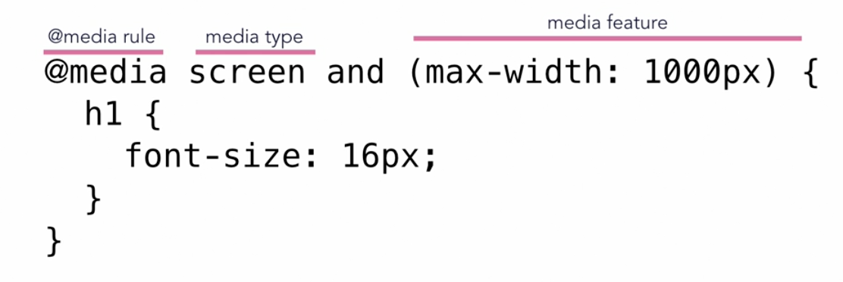
Using Media Queries
Media queries allow you to set CSS style rules based on the type of media and the device dimensions of the viewport. Example:

Slide 15
“Turning On” Media Queries in your HTML
In order to make sure that media queries are honored, you need to include a meta tag in the <head></head> of your html file:
<meta name="viewport" content="width=device-width, initial-scale=1.0">

Slide 16
Challenge: Can you make the card look different on a mobile device?

Slide 17
Outline
The Box Model
Semantic Tags (a reminder)
Media Queries
Intro to Flexbox

Slide 18
Flexbox Resources
Typically used when you have many child containers that you want to flow within a parent container.
Lets you specify a few generic rules that will control how the children of a container are positioned
Some resources:
Flexbox Froggy (interactive game)
Flexbox (course website)
Grid v. Flexbox: Which to use when?

Slide 19
Using Flexbox: Suggested Strategy
Parent Container Put the display into “flex mode” display: flex and then use the following properties to align the child items:
align-items: (flex-start, flex-end, space-around, space-between, center)
justify-content: (same as align-items)
flex-direction: (row, column, row-reverse, column-reverse)
flex-wrap: (no-wrap, wrap, wrap-reverse)
Child Container
Apply sizing to the child container as needed.
Notes:
Flex mode by default puts everything on the same row.

Slide 20
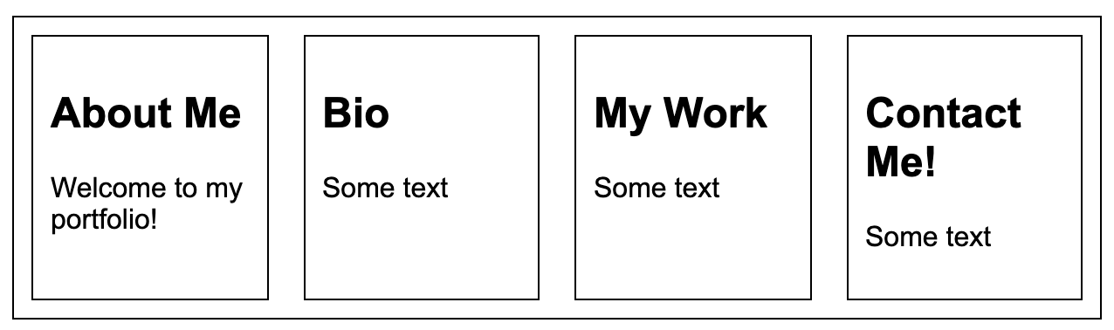
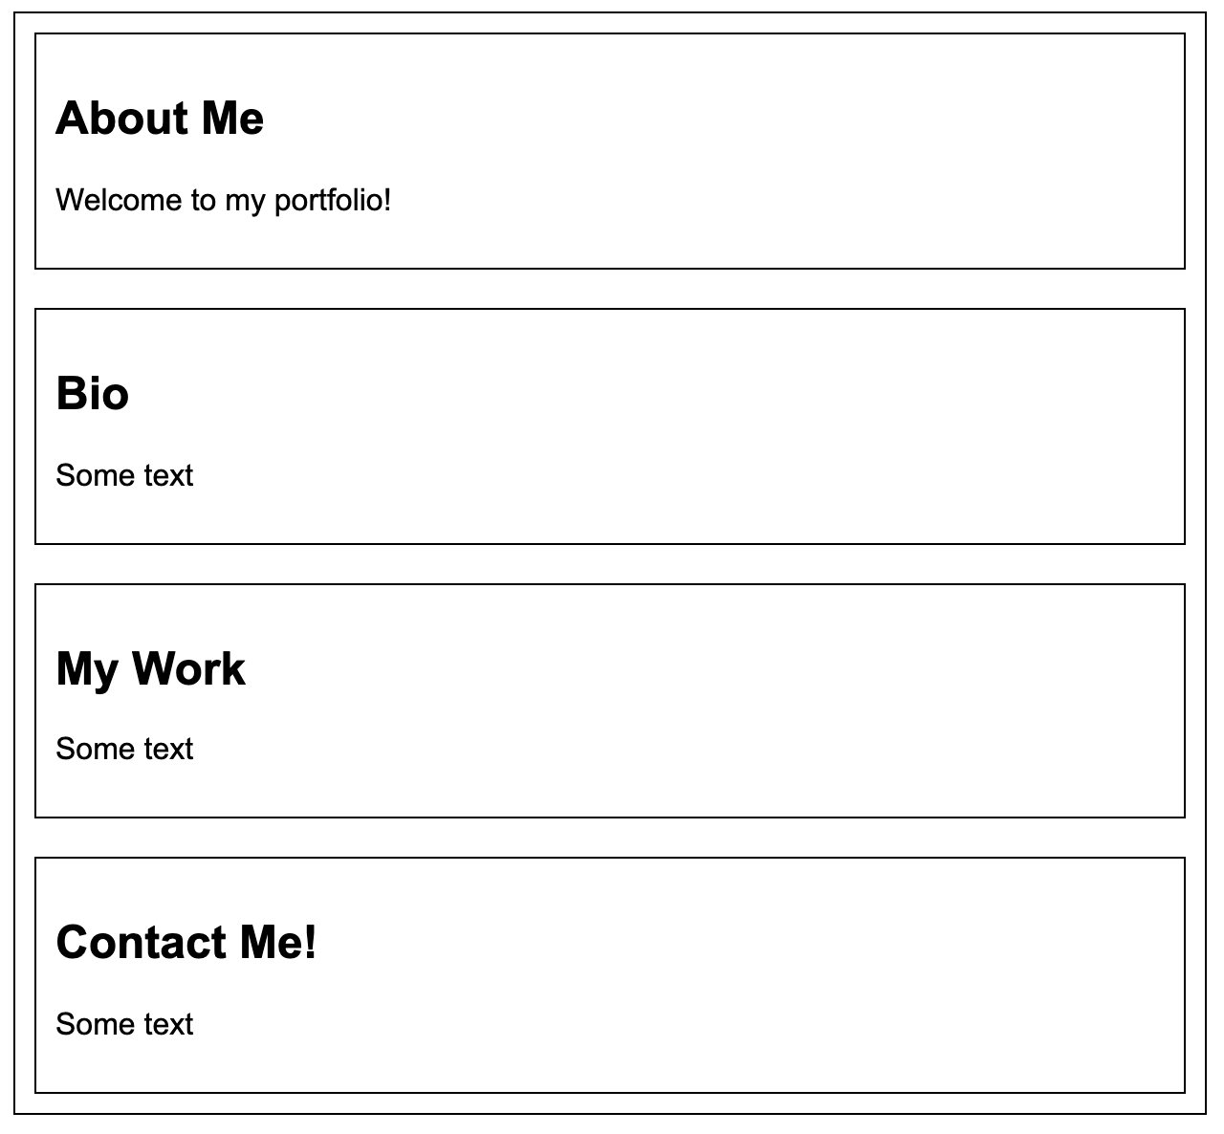
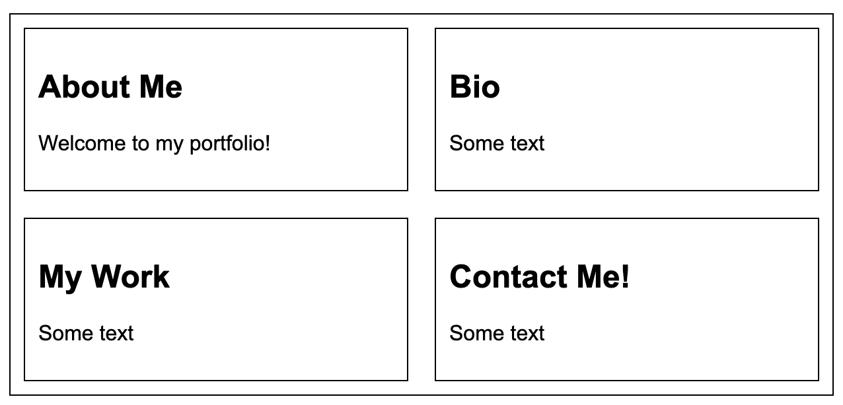
Flexbox: Practice 1
Open 02-flexbox. Can you create the following layouts?
1
3
2

Slide 21
Flexbox: Practice 1 Cont’d – Using Media Queries
Make it so that #1 is for Desktop screens, #2 is for Tablet, and #3 is for Mobile
1
3
2

Slide 22
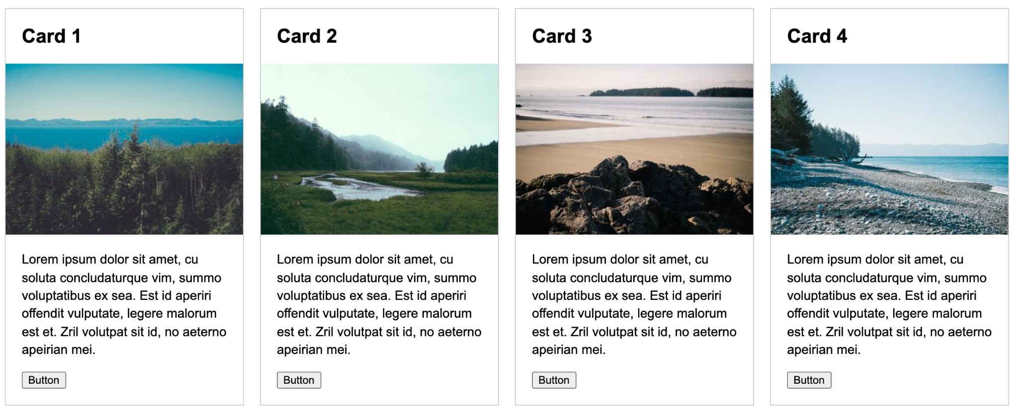
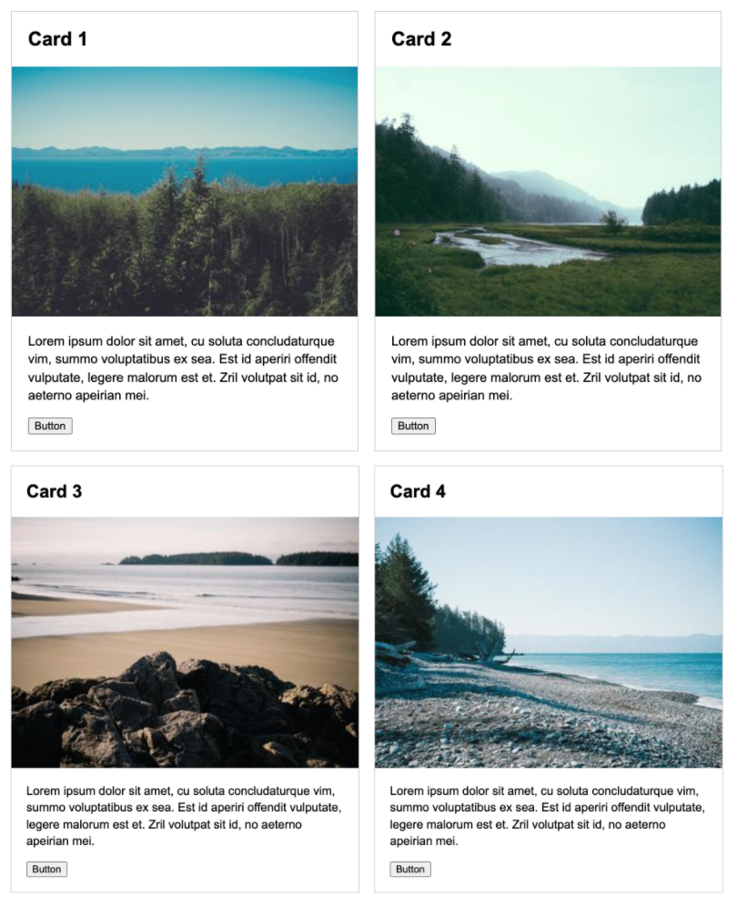
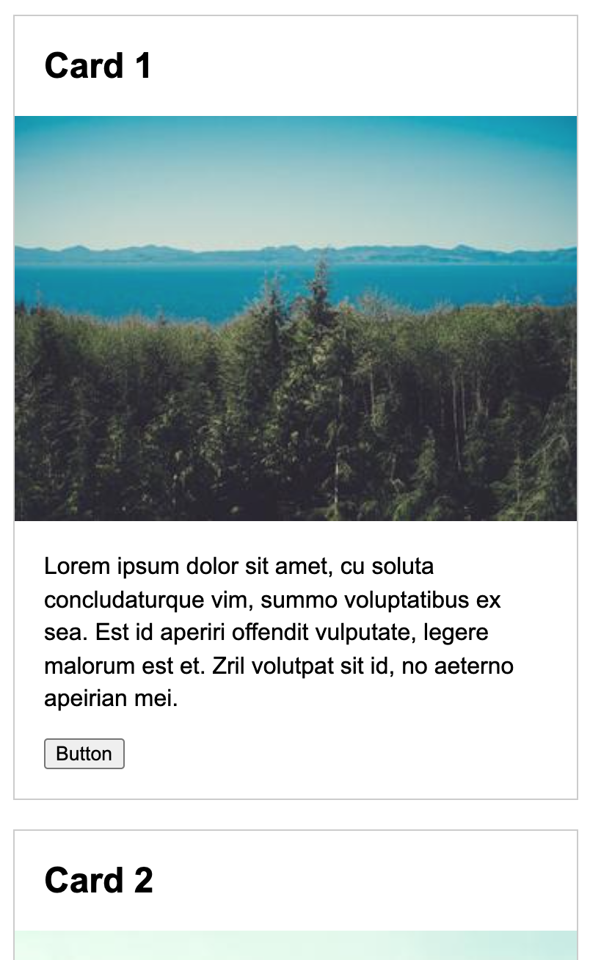
Flexbox: Practice 2 (Lab 1)
Open 03-flexbox-media-queries and create these screens:
Desktop
Tablet
Mobile

Slide 23
Flexbox: Practice 3: Navigation Bar
Open 04-nav-bar, and try to make the following:

